Slide 1
Special Course in Software Engineering ‘24
MINI-PROJECT PRESENTATION
GROUP NO. 16 Data Mining

Slide 2
Group Introduction

Slide 3
Group members and their contribution
Member Name | Contribution to the Mini-project
JiangZhou | Variable distribution,ANOVA/Kruskal Wallis,t-Test/Mann-Whitney U test,Regression,Sentiment Analysis,PPT
HeTao | Variable distribution,ANOVA/Kruskal Wallis,Chi-square Test,PPT
YanMingyu | PPT
ZhaKeyu | PPT

Slide 4
Dataset

Slide 5
Dataset introduction
Dataset name: Dietary Habits Survey Data
Brief description: The dataset is a survey on dietary habits and lifestyle, containing various variables related to eating and drinking patterns. Each row represents a respondent, recording their basic information (such as age, gender), daily eating habits, dietary preferences, and beverage consumption.
Variable | Type of data | Mean / Median / Mode | Kurtosis | Skewness | Normality
Age | Ordinal | NA | NA | NA | Non-normal
Gender | Nominal | NA | NA | NA | Non-normal
How many meals do you have a day? | Ratio | 3.128205/3.0/3.0 | 0.643847 | 0.436611 | Non-normal
How many times a week do you order-in or go out to eat? | Ratio | 1.897436/ 1.5/1 | 3.306579 | 1.739908 | Non-normal
What would best describe your diet: | Ordinal | NA | NA | NA | Non-normal

Slide 6
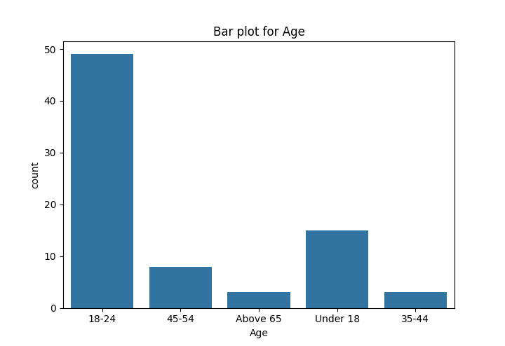
Age distribution
In the dataset, there are 78 valid age records, divided into 5 different groups. The most common age group is 18-24 years, which accounts for approximately 63% of the total data points.

Slide 7
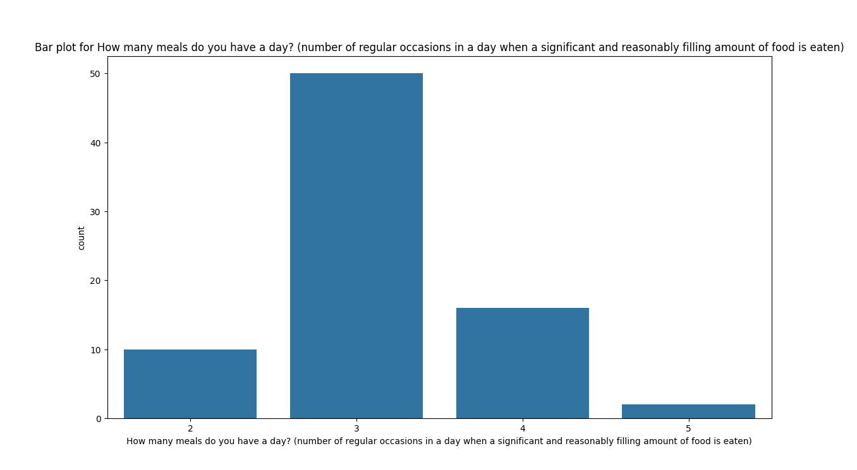
number of meals per day distribution
The mean number of meals per day is approximately 3.13.
The minimum number of meals reported is 2, and the maximum is 5.
This suggests that 3 meals a day is the most common eating pattern among the respondents. ​​

Slide 8
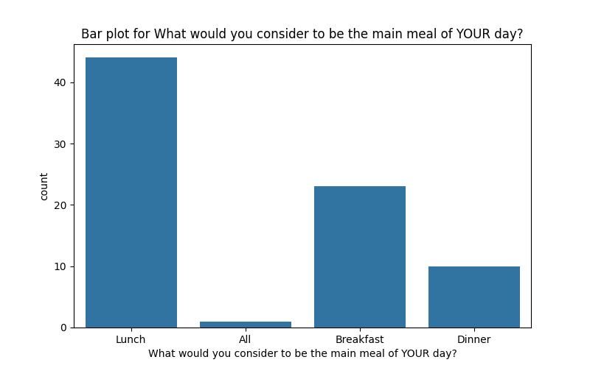
main meal of YOUR day distribution
44 respondents consider Lunch as their main meal.
23 respondents consider Breakfast as their main meal.
10 respondents consider Dinner as their main meal.
1 respondent considers all meals equally important.
Lunch is the most commonly considered main meal of the day among the respondents. ​​

Slide 9
Analysis

Slide 10
Hypothesis #1
H0 (Null Hypothesis): There is no relationship between gender and the habit of skipping meals.
Ha (Alternative Hypothesis): There is a relationship between gender and the habit of skipping meals.

Slide 11
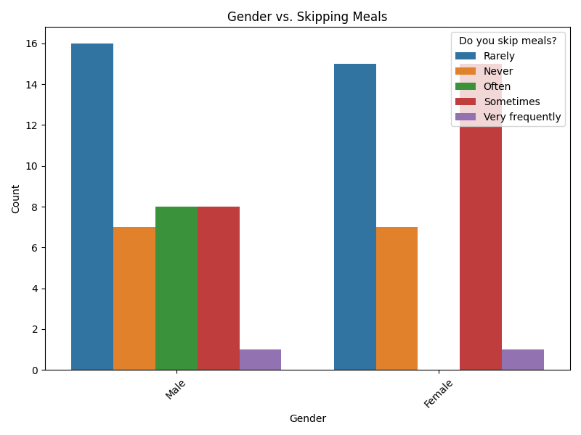
Testing Hypothesis #1.1 visualize the test

Slide 12
Testing Hypothesis #1.2 describe the results from the test
test results
Chi-squared: 10.118
p-value: 0.038
The Chi-Square test produced a Chi-squared statistic of 10.118 and a p-value of 0.038. The p-value is a measure of how likely it is to observe the given data if the null hypothesis is true. In this case, the p-value is below the common significance level of 0.05, suggesting that the observed differences in meal-skipping habits across genders are unlikely to have occurred by chance.

Slide 13
Testing Hypothesis #1.3 reject or fail to reject
Since the p-value (0.038) is less than the threshold of 0.05, we reject the null hypothesis H0​ . This means that there is sufficient evidence to conclude that there is a statistically significant relationship between gender and the habit of skipping meals in this dataset.

Slide 14
Hypothesis #2
H0 (Null Hypothesis): There is no relationship between age and the number of meals per day.
Ha (Alternative Hypothesis): There is a relationship between age and the number of meals per day.

Slide 15
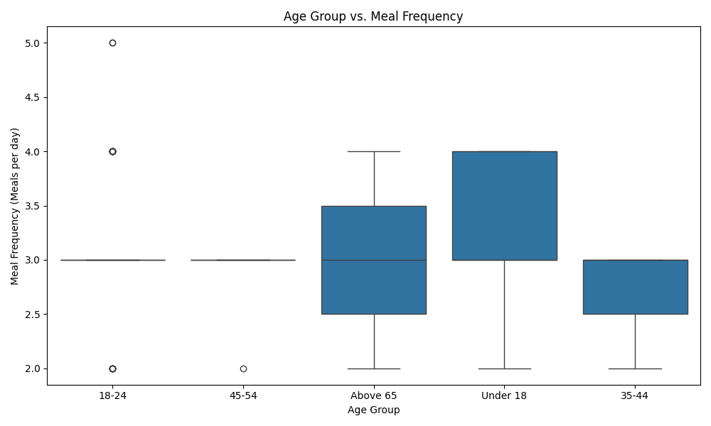
Testing Hypothesis #2.1 visualize the test

Slide 16
Testing Hypothesis #2.2 describe the results from the test
test results
Kruskal-Wallis: 4.02
p-value: 0.403
The Kruskal-Wallis test resulted in a statistic of 4.02 and a p-value of 0.403. Since the p-value is greater than 0.05, there is not enough evidence to support significant differences in meal frequency across different age groups.

Slide 17
Testing Hypothesis #2.3 reject or fail to reject
As the p-value exceeds 0.05, we fail to reject the null hypothesis. In other words, the data does not show a significant relationship between age and the number of meals per day.

Slide 18
Hypothesis #3
H0 (Null Hypothesis): There is no relationship between age group and the frequency of alcohol consumption.
Ha (Alternative Hypothesis): There is a relationship between age group and the frequency of alcohol consumption.

Slide 19
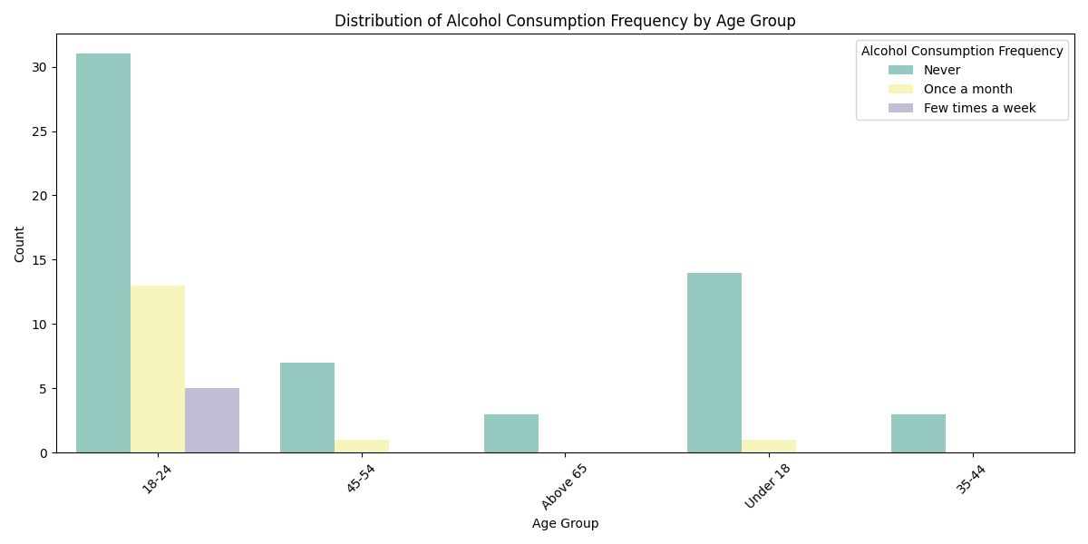
Testing Hypothesis #3.1 visualize the test

Slide 20
Testing Hypothesis #3.2 describe the results from the test
test results
Chi-square statistic (χ²): 9.14
P-value: 0.330
The chi-square test yielded a statistic of 9.14, with 8 degrees of freedom, and a p-value of 0.330. A higher value of χ² would indicate a stronger deviation from the null hypothesis. A p-value lower than 0.05 would indicate strong evidence against the null hypothesis, while a p-value greater than 0.05 suggests insufficient evidence to reject it.

Slide 21
Testing Hypothesis #3.3 reject or fail to reject
Since the p-value (0.330) is greater than the commonly used significance level of 0.05, we fail to reject the null hypothesis. This means that there is insufficient evidence to conclude that there is a significant relationship between age group and alcohol consumption frequency in this dataset.

Slide 22
Hypothesis #4
H0 (Null Hypothesis): There is no association between age groups and the frequency of sweet food consumption.
Ha (Alternative Hypothesis): There is an association between age groups and the frequency of sweet food consumption.

Slide 23
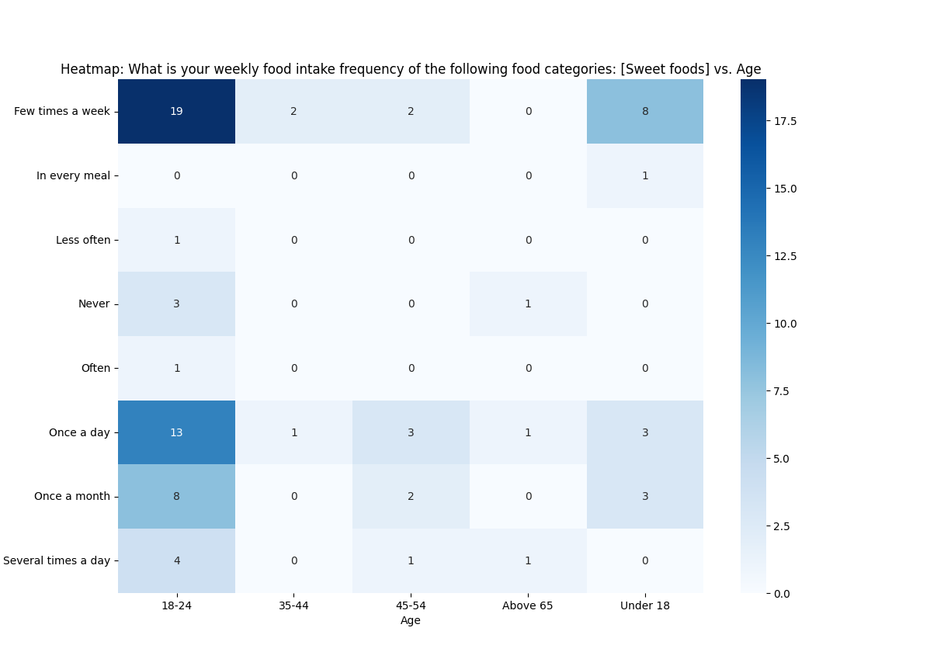
Testing Hypothesis #4.1 visualize the test

Slide 24
Testing Hypothesis #4.2 describe the results from the test
test results
Chi-square: 20.68
p-value: 0.838
The Chi-Square test produced a Chi-squared statistic of 20.68 and a p-value of 0.838. The p-value is a measure of how likely it is to observe the given data if the null hypothesis is true. In this case, the p-value is below the common significance level of 0.05, suggesting that the differences observed in the cross-tabulation between different age groups' sweet food consumption frequencies could very likely be due to chance rather than a true underlying association.

Slide 25
Testing Hypothesis #4.3 reject or fail to reject
Given the p-value of 0.838, which is much greater than the typical alpha level of 0.05, we fail to reject the null hypothesis. This indicates that there is no statistically significant association between age groups and the frequency of sweet food consumption based on the data provided.

Slide 26
Hypothesis #5
Null Hypothesis (H₀):
H₀: There is no significant linear relationship between the number of meals per day and the number of times out to eat per week.
Alternative Hypothesis (Hₐ):
Hₐ: There is a significant linear relationship between the number of meals per day and the number of times out to eat per week.

Slide 27
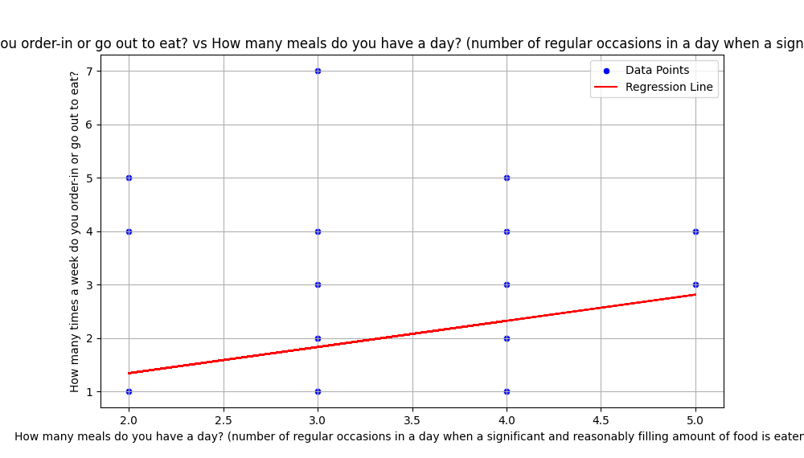
Running result

Slide 28
According to the picture, there is no significant linear relationship between the number of meals eaten per day and the number of meals eaten out per week. Therefore, the H0 hypothesis should be rejected

Slide 29
Hypothesis #6
Null Hypothesis (H₀):
There is no significant difference in the number of meals per day between different genders (i.e., the mean number of meals per day is the same across genders).
Alternative Hypothesis (Hₐ):
There is a significant difference in the number of meals per day between different genders (i.e., the mean number of meals per day is different for males and females).

Slide 30
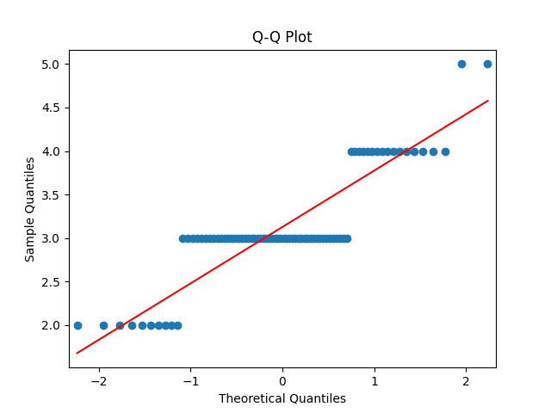
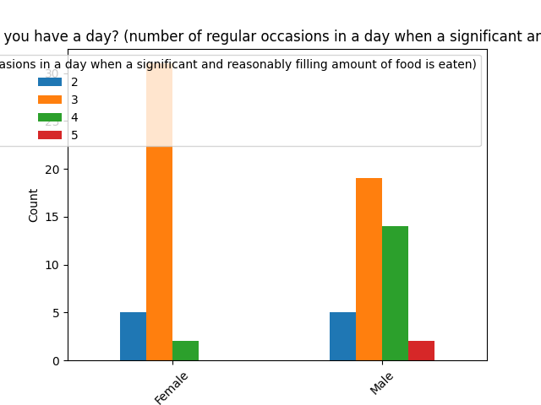
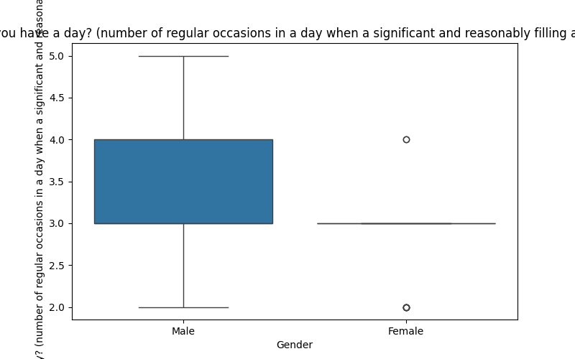
Shapiro-Wilk Test:
Statistic: 0.7860300447744776, p-value: 2.712346901387589e-09
Anderson-Darling Test:
Statistic: 8.630569522058124
Critical value: 0.55 for significance level 15.0
Critical value: 0.626 for significance level 10.0
Critical value: 0.752 for significance level 5.0
Critical value: 0.877 for significance level 2.5
Critical value: 1.043 for significance level 1.0
How many meals do you have a day? (number of regular occasions in a day when a significant and reasonably filling amount of food is eaten) is not normally distributed. Performing Kruskal-Wallis Test...
Test Statistic: 7.666962242562949, p-value: 0.005624106314683147
Null Hypothesis is rejected.
Test Statistic: 7.666962242562949, p-value: 0.005624106314683147

Slide 31
Statistic: 0.786
p-value: 2.71 × 10⁻⁹
The Shapiro-Wilk Test tests the null hypothesis that the data follows a normal distribution. The alternative hypothesis is that the data does not follow a normal distribution.
Since the p-value is extremely small (much less than 0.05), we reject the null hypothesis. This means that the data does not follow a normal distribution, and we can conclude that the distribution of the data significantly deviates from normal.
Both tests suggest that the data significantly deviates from a normal distribution. Therefore, the assumption of normality does not hold.

Slide 32
Hypothesis #7
Null Hypothesis (H₀):
There is no significant difference in sentiment scores between the water consumption texts.
Alternative Hypothesis (Hₐ):
There is a significant difference in sentiment scores between the water consumption texts.)

Slide 33
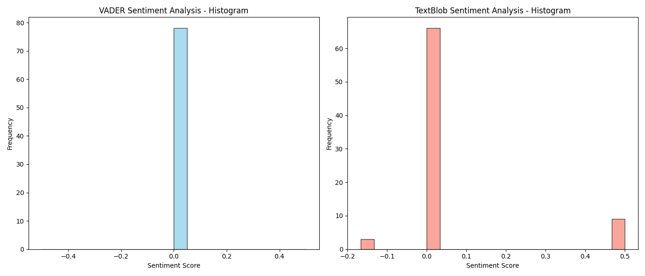
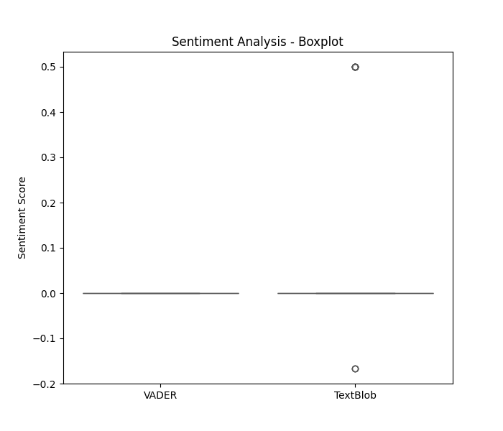

Slide 34
Most of the texts have sentiment scores (TextBlob Sentiment) close to 0, indicating that these texts have a neutral or non-significant emotional tone. Only a few texts show positive (0.5) or negative (-0.16666666666666666) deviations.
indicating no significant emotional tendency.The result seems to support the null hypothesis (H0), which states that there is no significant difference in the sentiment scores across the texts.

Slide 35
Hypothesis #8
Null Hypothesis (H₀):
The frequency of consumption of dairy beverages (such as milk, milkshakes, smoothies, buttermilk, etc.) was not significantly different from the results of sentiment analysis, that is, there was no significant positive or negative emotion.
Alternative Hypothesis (Hₐ):
The consumption frequency of dairy drinks (such as milk, milkshakes, smoothies, buttermilk, etc.) was significantly different from the results of sentiment analysis, that is, there were significant positive or negative emotions.

Slide 36
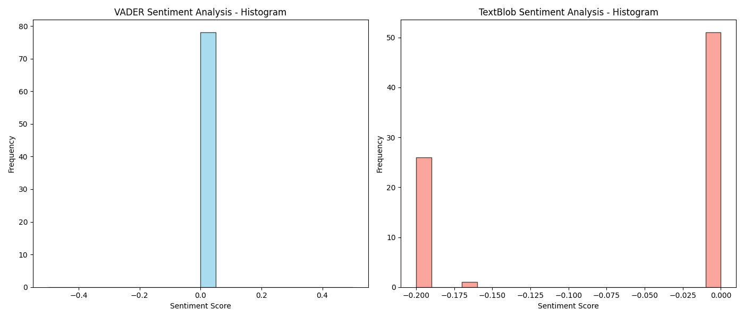
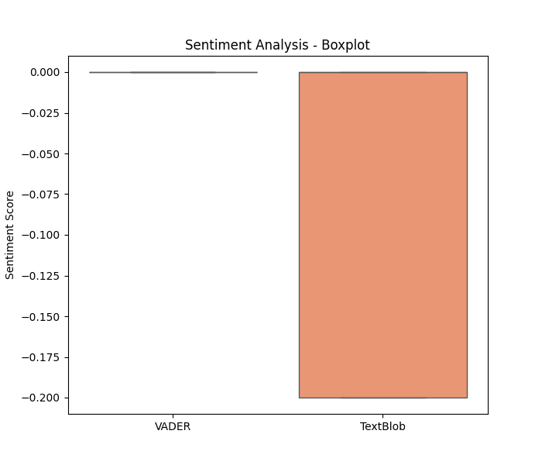

Slide 37
Almost all TextBlob Sentiment is negative (-0.2 or -0.16666666666666666), and a few are 0. This means that most texts express negative emotions rather than positive ones.Negative sentiment scores dominate, so the results do not support H0 because sentiment scores show a significant negative bias.
The running results did not support H0, but Ha, that is, sentiment analysis showed a significant relationship between dairy drinks and negative emotions.

Slide 38
(NOT MANDATORY)
Interesting results
BONUS – 5 points

Slide 39
Interesting Hypothesis (NOT MANDATORY)
H₀ : There is no relationship between the number of meals a person eats in a day and their experience of feelings of hunger during the day.
H_{a} : There is no relationship between the number of meals a person eats in a day and their experience of feelings of hunger during the day.

Slide 40
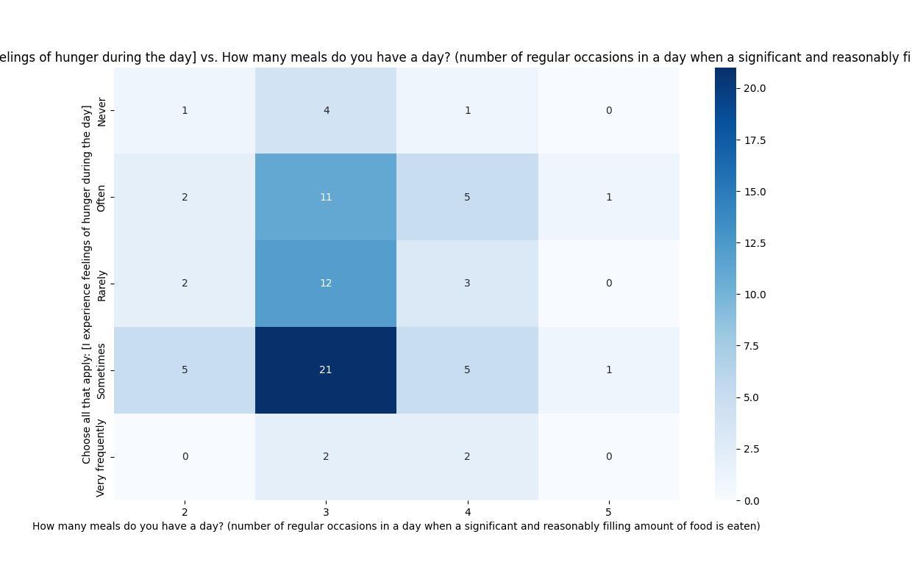
Interesting Hypothesis (NOT MANDATORY)
Picture shows how feelings of hunger are distributed across different numbers of meals per day

Slide 41
Test Results and Conclusion
The chi-square test gives the following results:
Chi-square statistic: 5.002
p-value: 0.958
Since the p-value is much higher than 0.05, we fail to reject the null hypothesis. This suggests that there is no statistically significant relationship between the number of meals a person eats per day and their experience of feelings of hunger during the day, at least based on the data provided.

Slide 42
Why the result is it interesting?
This result is particularly intriguing because it challenges our intuitive expectations about eating habits and the sensation of hunger. Commonly, one might assume that individuals who eat fewer meals per day would experience hunger more frequently. However, according to this analysis, there is no statistically significant relationship between the number of meals a person eats per day and their frequency of experiencing hunger. This suggests that hunger may be influenced by several other factors, such as:
Total caloric intake: Even if someone eats only a few meals a day, they might not feel hungry often if those meals are calorically sufficient.
Individual metabolic differences: People have different metabolic rates, which could affect the frequency and intensity of hunger.
Lifestyle and activity level: A higher level of activity might increase feelings of hunger, whereas a sedentary lifestyle could reduce the frequency of hunger.
Thus, this result might inspire us to consider more variables and complex interactions when studying the relationship between diet habits and hunger.

Slide 43
End

